Slide 1
JavaScript Advanced
Continuing Education, University of Calgary
Adnan Ahmed (aeahmed@ucalgary.ca)

Slide 2
Introduction
Adnan Ahmed
Email: aeahmed@ucalgary.ca

Slide 3
Introduction
  10 lecture in 5 weeks
  6pm to 9pm (Mon, Wed)
  Class structure
    lecture – introducing concepts + examples by Instructor
    In class activities to practice the concepts
    In class project to tie it all together
  Assignments – total of 3 (30%, 35%, 35%)
    Assignment 3 is a final project
  Quiz – Total of 2 (No graded)
  Last day : review of topics and or “spill over” topics
  Assignments must be submitted on D2L.
  1 point = 1 %

Slide 4
Introduction
Purpose and Goal of the class: To learn
  Advanced topics in JavaScript – focusing on objects, object oriented concepts, design patterns, libraries and API.
  After this course you should be comfortable in using JavaScript libraries, Objects and HTML5 JavaScript API to write complex applications in JavaScript.

Slide 5
Introduction
What you need for this course:
  Knowledge of using Google chrome and sometimes firefox
  Knowledge of using text editors
    Shortcut command to copy, cut and paste text will help
  Knowledge of HTML
  Knowledge of CSS
  Basic JavaScript knowledge

Slide 6
Introduction
Tools we will use for the course:
  Notepad++: free text editor available from:
    http://notepad-plus-plus.org/
  Google Chrome
  Chrome debugger / Devtools

Slide 7
Outline
Review of introductory JavaScript concepts
  Adding JavaScript to HTML
  Syntax and variables
  Data types
  Operators
  Arrays
  Loops
  Conditions
  Built in JavaScript objects
  Functions

Slide 8
Adding JavaScript to HTML
Best approach to place JavaScript in HTML
Independent of the HTML pages
Can be reused in multiple pages
Can be worked on independently of the design and content

Slide 9
Using External JavaScript File
How to create an External JavaScript File:
  External JavaScript file will have the extension .js
  It is just a text file with .js extension
  Does not have any markup or the <script> tag
  Will only contain comment and JavaScript Code.

Slide 10
Using External JavaScript File
<html>
  <head>
  <title> some tile here </title>
  <script src=“myJavaScript.js”></script>
  </head>
<body> </body>
</html>
This is the link to the javaScript File

Slide 11
JavaScript Syntax
JavaScript is case sensitive. keywords, variables, function names, and any other identifiers must always be typed with a consistent capitalization of letters.
The following are all different variable names
  myVariable
  Myvariable
  MYVARIABLE

Slide 12
JavaScript Syntax
JavaScript ignores white spaces and line breaks
  This allows you to format and indent your programs in a neat and consistent way
  There is one exception

Slide 13
JavaScript Syntax - Statement
Statement is a series of instructions to the programming language:
  e.g : var myVariable = 12;
In JavaScript
  two statements are separate if they are on sperate lines
    var myVariable
    myVarialbe = 12
    Can you put them in one line?

Slide 14
JavaScript Syntax - Statement
In one line: var myVariable; myVariable = 12;
Note: do not confuse with
  var myVariable, myVariable = 12;
“;” is not required in two lines but good practice
  var myVariable;
  myVariable = 12;
Makes it easy to follow the code

Slide 15
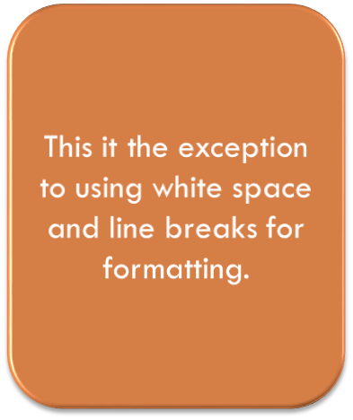
JavaScript Syntax - statement
Can not break a statement in two lines if
  line break of code is in such a way that the line before the break appears to be a complete statement,
  Example: return
  true;
  JavaScript will see this as return;
  true;

Slide 16
JavaScript Syntax - literals
A literal is a data value that appears directly in a program. The following are all literals:
  12 The number twelve
  1.2 The number one point two
  "hello world“ A string of text
  true // A Boolean
  null a null object
  etc…

Slide 17

JavaScript Syntax - Identifiers
An identifier is simply a name.
Used to name
  Variables
  Functions
  provide labels for certain loops in JavaScript code
Example:
  i
  my_variable_name
  v13 _dummy

Slide 18
JavaScript Syntax - Identifiers
The first character must be a letter, an underscore (_),
Subsequent characters can be a letter, a digit, an underscore, or a dollar sign
Numbers are not allowed as the first character so that JavaScript can easily distinguish identifiers from numbers
identifiers can't be the same as any of the keywords used for other purposes in JavaScript

Slide 19
JavaScript Syntax – Reserved word
Reserved keywords are words that cannot be used as identifiers
  variable names
  function names
  loop labels
Refer to http://www.w3schools.com/js/js_reserved.asp for JavaScript reserved words

Slide 20
JavaScript Syntax – Variables
A variable is a name associated with a value
variables store or contain the value
Variables are used to represent the things that are subject to change. E.g age, weight, distance etc.

Slide 21
JavaScript Syntax – Variables
Giving a value to a variable is called assignment.
Example
  age = 40;
  var name = “myname”;
When a variable has been assigned a value, we say that the variable contains the value.
  For example, the variable age contains 40

Slide 22
JavaScript Syntax – Variables
Unlike other programming languages you don’t have to declare a variable before assigning value
  Myname = “Adnan”;
But declaring is a good practice
  var MyName = “Adnan”;
Declare multiple variables in one line
  var myName, age, height, address;

Slide 23
JavaScript Syntax – Variables
Many ways of declaring variable and assignments
  var myName;
  myName = “Adnan”;
  var myName = “Adnan”;
  var myName, age;
  myName = “adnan”;
  age = 40;

Slide 24
JavaScript Syntax – Variables
var myName = “adnan”, age = 40;
Variable names can contain
  Letters
  Numbers
  dollar symbols
  underscores.
  To make long variables more readable you can use underscore:
    var my_mailing_address = “123 street";

Slide 25
JavaScript Syntax – Variables
Identify the literal and the variable name:
  var myname = “adnan”;

Slide 26
JavaScript Syntax – Variables
Identify the literal and the variable name:
  var myname = “adnan”;
keyword
String literal
Variable name

Slide 27
JavaScript Syntax – Variables
If you don't specify an initial value for a variable with the var statement, the variable is declared, but its initial value is undefined until your code stores a value into it.

Slide 28
JavaScript Syntax – Variables
A variable can be declared more than once with the var statement.
If the repeated declaration has an initializer, it acts as if it were simply an assignment statement
** Initializer is the assignment of a value at the time of declaring the variable
  var myName = “no name” (this is initialization)

Slide 29
JavaScript Syntax – Variables
If you attempt to read the value of an undeclared variable, JavaScript generates an error.
If you assign a value to a variable that you have not declared with var, JavaScript implicitly declares that variable for you.

Slide 30
JavaScript Syntax – Variables
Note, however, that implicitly declared variables are always created as global variables, even if they are used within the body of a function
  We will discuss what the body of a function means and how it is different from declaring variables as “global”

Slide 31
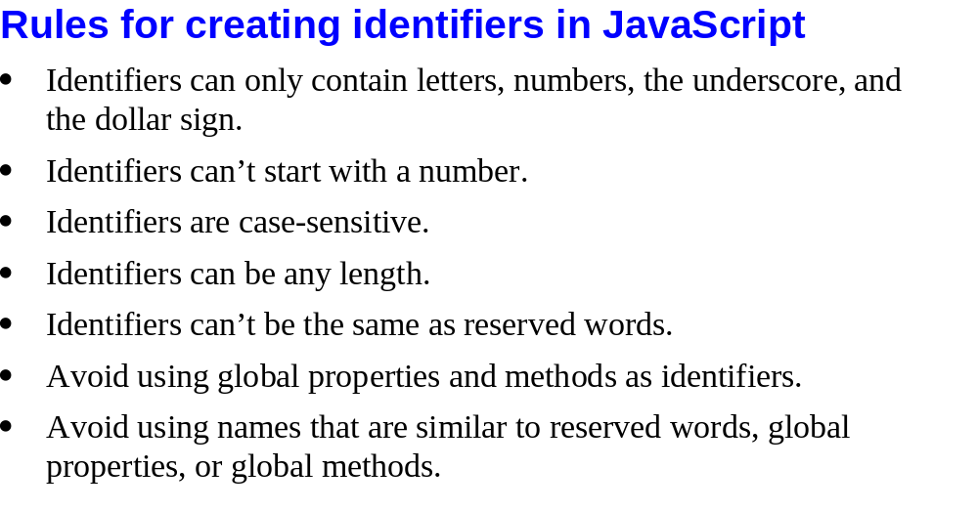
Variables – Recap:

Slide 32
Undefined VS Unassigned
there are two different kinds of undefined variables.
  one that has never been declared. An attempt to read the value of such an undeclared variable causes a runtime error.
  Undeclared variables are undefined because they simply do not exist.
    Remember: Assigning a value to an undeclared variable does not cause an error; instead, it implicitly declares the variable in the global scope.

Slide 33
Undefined VS Unassigned
The second kind of undefined variable is one that has been declared but has never had a value assigned to it – this is the Unassigned variable.
If you read the value of one of these variables, you obtain its default value, undefined.
This type of undefined variable might more usefully be called unassigned, to distinguish it from the more serious kind of undefined variable that has not even been declared and does not exist.

Slide 34
Undefined VS Unassigned
var myName;
document.write(myName);
VS
var myName;
document.write(firstName);
MyName is unassigned
firstName is undefined

Slide 35
Data Types
Two types of Data (that can be contained in variables)
  Primitive Types
    Numbers
    String (text)
    Boolean
    Trivial data types (defines only a single value)
      Null
      Undefined
  Reference Types
    Objects
    Arrays
    Functions

Slide 36
Primitive VS Reference Data Type
Primitive Data type has a fixed size in memory
  Integers, strings, boolean can only take up a fixed memory
Reference Data Type has no fixed size
  Objects can grow.

Slide 37
Primitive Data Type - Number
Number variables contain a numeric value
Can contain whole numbers as well as fractions (floating-point)
  Example: var age = 35;
  var price = 3.25;
  var temperature = -20;

Slide 38
Primitive Data Type - Number
Some special numbers
  Infinity: Special value to represent infinity
  NaN: Special not-a-number value
  Number.MAX_VALUE: Largest representable number
  Number.MIN_VALUE: Smallest (closest to zero) representable number
  Number.NaN : Special not-a-number value
  Number.POSITIVE_INFINITY Special value to represent infinity
  Number.NEGATIVE_INFINITY : Special value to represent negative infinity

Slide 39
Primitive Data Type - Strings
Strings consist of zero or more characters
Characters include letters, numbers, punctuation marks, and spaces.
  “abc” “a23” “” “%” etc
Strings must be enclosed in quotes.
  “this is a string with number 12”
You can use either single quotes or double quotes
  “abc” ‘abc’

Slide 40
Primitive Data Type - Strings
var mood = 'happy';
var mood = "happy";
To have a quote as part of the string:
  Use the alternate quote
  When you have single quote (‘) as part of your string use double (“ “) quote to surround and vice versa
  Example: var mood = "don't ask";

Slide 41
Primitive Data Type - Strings
You can also use escape to include quotes in the string
Example
  var mood = “don\'t ask”;
  var height = "about 5'10\" tall";

Slide 42
Primitive Data Type - Strings
Other Escape Sequence
  \0 The NULL character
  \b Backspace
  \t Horizontal tab
  \n Newline
  \v Vertical tab
  \f Form feed
  \r Carriage return
  \" Double quote
  \' Apostrophe or single quote
  \\ Backslash
  NOTE: the \n \ r will only show effects in JavaScript strings but not in the mark up. For example the effect will be seen in alert but not in document.write()

Slide 43
Primitive Data Type - Boolean
Boolean data has just two possible values:
  true
  false
var married = true; (here married has a boolean value)
var married = "true“ (here married has a string value)

Slide 44
Null
JavaScript keyword null is a special value that indicates no value.
null is usually considered a special value of object type—a value that represents no object.
null is a unique value, distinct from all other values
When converted to number it will show 0
When converted to string it will show “null”

Slide 45
Undefined
undefined is returned when
  you use either a variable that has been declared but never had a value assigned to it
  or an object property that does not exist.
Since both null and the undefined value indicate an absence of value,
null == undefined

Slide 46
JavaScript Syntax – Variable typing
var unit = 20; (20 is number literal)
unit = “upper”; (“upper” is string literal)
Notice that unit can have both a string and a number. JavaScript won’t complain
Most programming languages are strongly typed
JavaScript is “weakly typed”
  You do not have to declare the type of the variable.

Slide 47
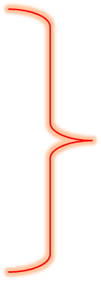
Working with primitive types - String
Define a variable that will hold the main string
//Declare the string variables
var mainStr;
mainStr = "This isn\'t too bad";

Slide 48
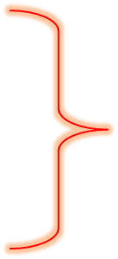
Working with primitive types - String
Define a variable that will hold the main string
//Declare the string variables
var mainStr;
mainStr = "This isn\'t too bad";
document.write('The string we want to work with is <b>' + mainStr + "</b>");

Slide 49
Working with primitive types - String
You can include markup (e.g <b> </b>) within your string and it will be interpreted as html markup.
This means we can write entire html documents using JavaScript (dynamically generated documents)
Also notice that you can mix and match quotes in the string … however try to be consistent with your quotes.

Slide 50
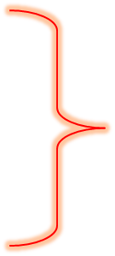
Working with primitive types - String
Define a variable that will hold the length of the string
document.write('The string we want to work with is <b>' + mainStr + "</b>");
var strLength;
strLength = 0;
Initialization

Slide 51
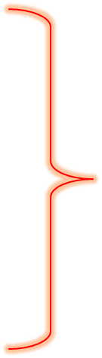
Working with primitive types - String
Store the length in strLength
var strLength;
strLength = 0;
strLength = mainStr.length;
document.write("<br /><br />");
document.write("The length of the mainStr is : " + strLength);

Slide 52
Working with primitive types - String
To join two string together use one of the following
  +
  concat(string1, string2)

Slide 53
Working with primitive types - Number
Basic numbers are
  Integers (whole numbers – 1,2,10)
  Floating point (fractions/decimals - 1.3 , .443)
JavaScript does not make a distinction between integer values and floating-point values
All numbers in JavaScript are represented as floating-point values
When a number appears directly in a JavaScript program, it's called a numeric literal
A list of string function can be found at
http://www.w3schools.com/jsref/jsref_obj_string.asp

Slide 54
Working with primitive types - Number
Integer Literals
  In a JavaScript program, a base-10 integer is written as a sequence of digits. For example:
    0
    3
    10000000

Slide 55
Working with primitive types - Number
Floating point literals
  Floating-point literals can have a decimal point; they use the traditional syntax for real numbers.
  Floating-point literals may also be represented using exponential notation:
    a real number followed by
    the letter e (or E), followed by
    an optional plus or minus sign, followed by
    an integer exponent.

Slide 56
Working with primitive types - Number
  This floating point notation represents the real number multiplied by 10 to the power of the exponent.
  Example:
    3.14
    2345.789
    .333333333333333333 6.02e23 // 6.02 x 10²³
    1.4738223E-32 // 1.4738223 x 10⁻³²

Slide 57
Working with primitive types - Number
JavaScript programs work with numbers using the arithmetic operators
  + (2 + 2 = 4) for addition
  - ( 4 – 2 = 2) for subtraction
  * (2*3 = 6) for multiplication
  / (32/8 = 4) for division

Slide 58
Working with primitive types - Number
Numbers are automatically converted to string when concatenated to a string
  var num = 23;
  var str = “the number of cans is “;
  var stmt = str + num;
  Explicitly
    var string_value = String(number);

Slide 59
Primitive Data Type - Number
Some special numbers
  Infinity: Special value to represent infinity
  NaN: Special not-a-number value
  Number.MAX_VALUE: Largest representable number
  Number.MIN_VALUE: Smallest (closest to zero) representable number
  Number.NaN : Special not-a-number value
  Number.POSITIVE_INFINITY Special value to represent infinity
  Number.NEGATIVE_INFINITY : Special value to represent negative infinity

Slide 60
Working with primitive types - Number
Math Object:
  In addition to the basic arithmetic operations, JavaScript supports more complex mathematical operations through a large number of mathematical functions that are a core part of the language. For convenience, these functions are all stored as properties of a single Math object,

Slide 61
Working with primitive types - Number
String to Number conversion
When a string is used in a numeric context, it is automatically converted to a number. This means, for example, that the following code actually works:
var product = "21" * "2"; // product is the number 42.

Slide 62
Working with primitive types - Number
Explicitly
  var number = Number(string_value);
  Try converting the string “23”
  Try converting the string “google”
  Use document.write to show your result

Slide 63
Working with primitive types - Number
parseInt() and parseFloat()
  These functions convert and return any number at the beginning of a string, ignoring any trailing nonnumbers.
  parseInt( ) parses only integers
  parseFloat( ) parses both integers and floating-point numbers.

Slide 64
Working with primitive types - Number
ParseInt() and ParseFloat()
  parseInt("3 blind mice"); // Returns 3
  parseFloat("3.14 meters"); // Returns 3.14
  parseInt("12.34"); // Returns 12
  parseInt("0xFF"); // Returns 255

Slide 65
Working with primitive types - Boolean
Two values
  true
  false
Example
  document.writeln("is 1 = 4? : " + 1==4);

Slide 66
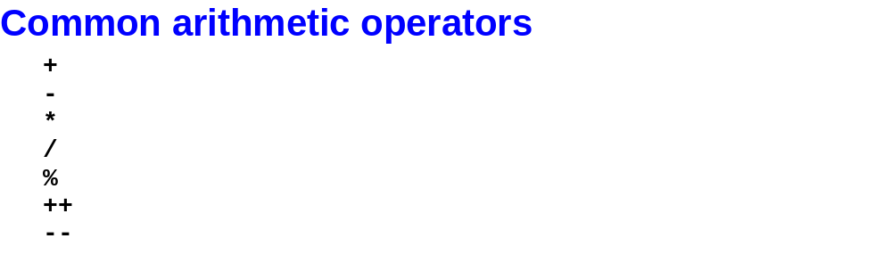
Arithmetic Operators

Slide 67
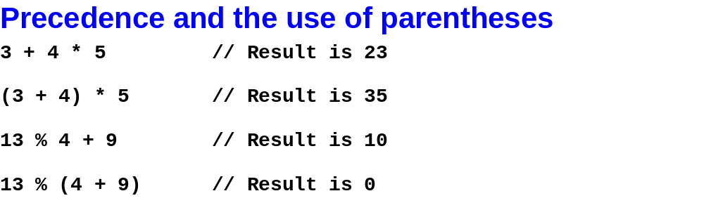
Precedence of operators

Slide 68
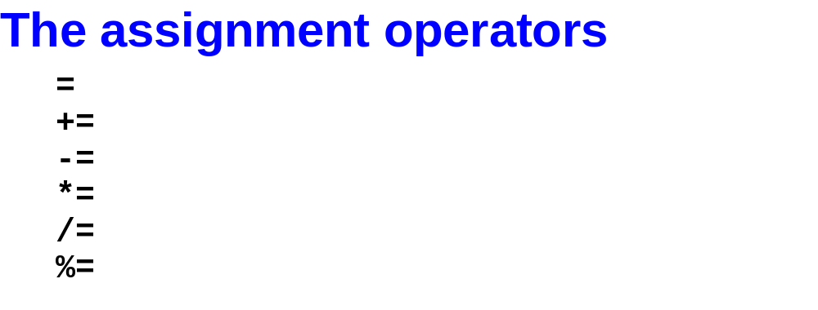
Assignment operators

Slide 69
JavaScript : Operators
Arithmetic Operators
Equality Operators
Relational Operators
String Operators
Logical Operators
Assignment Operators
Conditional Operator

Slide 70
Arithmetic Operators
Addition (+)
The + operator adds numeric operands or concatenates string operands.
If one operand is a string, the other is converted to a string, and the two strings are then concatenated.
Object operands are converted to numbers or strings that can be added or concatenated.
When working with objects the conversion is performed by the valueOf( ) method and/or the toString( ) method of the object.

Slide 71
Arithmetic Operators
Subtraction (-)
When - is used as a binary operator, it subtracts its second operand from its first operand.
If used with nonnumeric operands, it attempts to convert them to numbers.

Slide 72
Arithmetic Operators
Multiplication (*)
The * operator multiplies its two operands. If used with nonnumeric operands, it attempts to convert them to numbers.

Slide 73
Arithmetic Operators
Division (/)
The / operator divides its first operand by its second.
If used with nonnumeric operands, it attempts to convert them to numbers.
In JavaScript all numbers are floating-point, so all division operations have floating-point results: 5/2 evaluates to 2.5, not 2.
Division by zero yields positive or negative infinity
while 0/0 evaluates to NaN.

Slide 74
Arithmetic Operators
Modulo (%)
The % operator returns the remainder when the first operand is divided by the second operand
If used with nonnumeric operands, the modulo operator attempts to convert them to numbers.
The sign of the result is the same as the sign of the first operand. For example, 5 % 2 evaluates to 1.
While the modulo operator is typically used with integer operands, it also works for floating-point values. For example, -4.3 % 2.1 evaluates to -0.1.

Slide 75
Arithmetic Operators
Unary minus (-)
When - is used as a unary operator, before a single operand, it performs unary negation.
In other words, it converts a positive value to an equivalently negative value, and vice versa.
If the operand is not a number, this operator attempts to convert it to one.

Slide 76
Arithmetic Operators
Unary plus (+)
For symmetry with the unary minus operator, JavaScript also has a unary plus operator. This operator allows you to explicitly specify the sign of numeric literals, if you feel that this will make your code clearer:
var profit = +1000000;
In code like this, the + operator does nothing; it simply evaluates to the value of its argument.
for nonnumeric arguments, the + operator has the effect of converting the argument to a number.
returns NaN if the argument cannot be converted.

Slide 77
Arithmetic Operators
Increment (++)
The ++ operator increments (i.e., adds 1 to) its single operand, which must be
  a variable
  an element of an array
  or a property of an object.

Slide 78
Arithmetic Operators
If the value of this variable, element, or property is not a number
  the operator first attempts to convert it to one.
  The precise behavior of this operator depends on its position relative to the operand.
  When used before the operand, where it is known as the pre-increment operator, it increments the operand and evaluates to the incremented value of that operand.
  When used after the operand, where it is known as the post-increment operator, it increments its operand but evaluates to the unincremented value of that operand.
  If the value to be incremented is not a number, it is converted to one by this process.

Slide 79
Arithmetic Operators
For example, the following code sets both i and j to 2:
i = 1; j = ++i;
But these lines set i to 2 and j to 1:
i = 1; j = i++;

Slide 80
Arithmetic Operators
Decrement (--)
The -- operator decrements (i.e., subtracts 1 from) its single numeric operand, which must be a variable, an element of an array, or a property of an object.
Conversion works the same way as the ++ operator

Slide 81
Equality Operators
Equality (==) and Identity (===)
The == and === operators check whether two values are the same
Both operators accept operands of any type, and both return true if their operands are the same and false if they are different.

Slide 82
Equality Operators
The === operator is known as the identity operator, and it checks whether its two operands are "identical" using a strict definition of sameness.
The == operator is known as the equality operator; it checks whether its two operands are "equal" using a more relaxed definition of sameness that allows type conversions.

Slide 83
Equality Operators
To make things simple:
  read "gets or is assigned" for =
  "is equal to" for ==
  and "is identical to" for ===.

Slide 84
Relational Operators
Less than (<)
  evaluates to true if its first operand is less than its second operand;
Greater than (>)
  evaluates to true if its first operand is greater than its second operand
Less than or equal (<=)
  evaluates to true if its first operand is less than or equal to its second operand
Greater than or equal (>=)
  evaluates to true if its first operand is greater than or equal to its second operand

Slide 85
Relational Operators
The operands of these comparison operators may be of any type. Comparison can be performed only on numbers and strings
Comparison and conversion occur as follows:
  If both operands are numbers, or if both convert to numbers, they are compared numerically.
  If both operands are strings or convert to strings, they are compared as strings.

Slide 86
Relational Operators
If one operand is or converts to a string, and one is or converts to a number, the operator attempts to convert the string to a number and performs a numerical comparison. If the string does not represent a number, it converts to NaN, and the comparison is false.
If an object can be converted to either a number or a string, JavaScript performs the numerical conversion. This means, for example, that Date objects are compared numerically, and it is meaningful to compare two dates to see whether one is earlier than the other.
If the operands of the comparison operators cannot both be successfully converted to numbers or to strings, these operators always return false.
If either operand is or converts to NaN, the comparison operator always yields false.

Slide 87
Logical Operator
Logical AND (&&)
  When used with Boolean operands, the && operator performs the Boolean AND operation on the two values: it returns true if and only if both its first operand and its second operand are true.

Slide 88
Logical Operator
Logical OR (||)
  When used with Boolean operands, the || operator performs the Boolean OR operation on the two values: it returns true if either the first operand or the second operand is true, or if both are true.

Slide 89
Logical Operator
Logical NOT (!)
  The ! operator is a unary operator; it is placed before a single operand. Its purpose is to invert the boolean value of its operand.

Slide 90
Conditional Operator
  JavaScript also contains a conditional operator that
  assigns a value to a variable based on some condition
Syntax
  variablename=(condition)?value1:value2
Example
  greeting=(visitor=="PRES")?"Dear President ":"Dear ";

Slide 91
JavaScript : Operators - Recap
Arithmetic Operators (+,- , / , * , %)
Equality Operators (=, == , ===, !=, !==)
Relational Operators (< , > , >= , <=)
String Operators (+)
Logical Operators (&&, ||, !)
Assignment Operators (=)
Conditional Operator (?)

Slide 92
Functions
A function is a block of JavaScript code that is
  defined once but may be invoked, or executed, any number of times.
  Functions may have parameters, or arguments—local variables whose value is specified when the function is invoked.
  Code in functions do not execute as soon as the page loads, the function has to be called / invoked for the code to execute.

Slide 93
Functions
document.write(“<br />”);
document.write(“--------------”);
document.write(“<br />”);
document.write(“My name here”);
document.write(“<br />”);
document.write(“--------------”);
document.write(“<br />”);
document.write(“My Address here”);

Slide 94
Functions
Function format()
{
document.write(“<br />”);
document.write(“--------------”);
document.write(“<br />”);
}
format();
Document.write(“my name here”);
format();

Slide 95
Functions
Function format()
{
document.write(“<br />”);
document.write(“---*****---”);
document.write(“<br />”);
}
format();
Document.write(“my name here”);
format();

Slide 96



Functions
Function format:
function name(arguments)
{
  statements;
  Return (string, number, boolean, object etc)
}

Slide 97
Defining a JavaScript Function
Function without argument
function formatMe()
{
  Document.write(“---------”);
}

Slide 98
Defining a JavaScript Function
Function with 1 argument
function formatMe(txt)
{
  Document.write(txt);
}

Slide 99
Defining a JavaScript Function
Function with 2 argument
function formatMe(txt,name)
{
  Document.write(txt);
  Document.write(name);
}

Slide 100
Defining a JavaScript Function
Function with 2 argument and a return
function formatMe(txt,name)
{
  Document.write(txt);
  Document.write(name);
  Return name+txt;
}

Slide 101
Functions
Nested function
  Functions can be called from other functions
  function hypotenuse(a, b)
  {
      function square(x) { return x*x; }
      return Math.sqrt(square(a) + square(b));
      }

Slide 102
JavaScript Syntax – Variable Scope
The scope of a variable is the region of your program in which it is defined
  A global variable has global scope; it is defined everywhere in your JavaScript code.

Slide 103
JavaScript Syntax – Variable Scope
  Variables declared within a function are defined only within the body of the function. They are local variables and have local scope.
  Function parameters also count as local variables and are defined only within the body of the function.

Slide 104
JavaScript Syntax – Variable Scope
Within the body of a function, a local variable takes precedence over a global variable with the same name.
If you declare a local variable or function parameter with the same name as a global variable, you effectively hide the global variable. For example, the following code prints the word "local"

Slide 105
JavaScript Syntax – Variable Scope
Although you can get away with not using the var statement when you write code in the global scope, you must always use var to declare local variables. Consider what happens if you don't:

Slide 106
Functions as literals
JavaScript allows functions to be defined with function literals
function literal is an expression that defines an unnamed function.
The syntax for a function literal is much like that of the function statement except no function name is required.

Slide 107
Functions as literals
function f(x) { return x*x; } // function statement
var f = function(x) { return x*x; }; // function literal
document.write(f);
document.write(f(2));

Slide 108
Functions as data
In JavaScript, functions are not only syntax but also data, which means that they can be
  assigned to variables
  stored in the properties of objects or
  the elements of arrays
  passed as arguments to functions

Slide 109
Functions as data
function square(x) { return x*x; }
the definition above creates a new function object and assigns it to the variable square.
The name of a function is simply the name of a variable that refers to the function.

Slide 110
Functions as data
The function can be assigned to another variable and still work the same way:
function square(x) { return x*x; }
var a = square(4); // a contains the number 16
var b = square; // Now b refers to the same function that square does
var c = b(5); // c contains the number 25

Slide 111
Functions as data
Functions can also be assigned to object properties rather than global variables. When you do this, they're called methods:
var o = new Object;
// function literal
o.square = function(x) { return x*x; }
// y equals 256
y = o.square(16);

Slide 112
Functions as data
Function assigned to array
var a = new Array(3);
a[0] = function(x) { return x*x; }
a[1] = 20;
// a[2] contains 400
a[2] = a[0](a[1]);

Slide 113
Function Properties and Methods
typeof
  the typeof operator returns the string "function" when applied to a function
  typeof function name / variable assigned to function
length
  This read-only property returns the number of arguments that the function expects to be passed
  that is, the number of parameters it declares in its parameter list
  functionName.length

Slide 114
Arrays
The Array object is used to store multiple values in a single variable.
It is a collection of data values.
Each data value in an array has a number, or index.
Arrays may contain any type of JavaScript data, including references to other arrays or to objects or functions.

Slide 115
Arrays
JavaScript does not support multidimensional arrays, except as arrays of arrays.
Because JavaScript is an untyped language, the elements of an array do not all need to be of the same type,
0
0
1
2
1
2

Slide 116
Arrays
Creating arrays using the Array() keyword
var a = new Array( );
a[0] = 1.2; a[1] = "JavaScript";
a[2] = true;
a[3] = {1,3 };

Slide 117
Arrays
Arrays can also be initialized by passing array elements to the Array( ) constructor
var a = new Array(1.2, "JavaScript", true, { 1, 3 });

Slide 118
Arrays
If you pass only a single number to the Array( ) constructor, it specifies the length of the array.
var a = new Array(10);
Creates a new array a with length 10

Slide 119
Arrays
Access an Array
  You can refer to a particular element in an array by referring to the name of the array and the index number. The index number starts at 0.
  Example:
document.write(myCars[0]);

Slide 120
Arrays
Modify Values in an Array
  To modify a value in an existing array, just add a new value to the array with a specified index number:
myCars[0]="Opel";

Slide 121
Array functions
function | Definition
join() | Puts all the elements of an array into a string. The elements are separated by a specified delimiter
pop() | Removes and returns the last element of an array
push() | Adds one or more elements to the end of an array and returns the new length
reverse() | Reverses the order of the elements in an array
shift() | Removes and returns the first element of an array
slice() | Returns selected elements from an existing array
sort() | Sorts the elements of an array
splice() | Removes and adds new elements to an array
toSource() | Represents the source code of an object
toString() | Converts an array to a string and returns the result
unshift() | Adds one or more elements to the beginning of an array and returns the new length
valueOf() | Returns the primitive value of an Array object

Slide 122
Array functions
Array Exercise
  Refer to hand out for function and examples.

Slide 123
Conditional Statement
Used to perform different actions based on different conditions.
if
If , else
if , else if , else
switch

Slide 124
Conditional Statement
Single condition (if)
  execute the code only if the specified condition is true.
var temperature = "warm";
function mySingleCond()
{
var weather = "not nice";
if(temperature == "warm")
weather = "nice";
document.write("the weather is " + weather);
}
check Condition
Action if condition is true

Slide 125
Conditional Statement
Two condition (if, else)
  Executes one action if condition is true, otherwise executes another action.
  if(condition)
  {
  action
  }
  else
  {
    another action
  }

Slide 126
Conditional Statement
Two condition (if, else)
Style 2
Style 1
function returnLarger(num1,num2)
{
if(num1 > num2)
{
return num1;
}
else
{
return num2;
}
}
function returnLarger(num1,num2)
{
if(num1 > num2)
return num1;
else
return num2;
}
NOTE: it is possible to have nested if statements as well.

Slide 127
Conditional Statement
More then two conditions (if, else if, else)
  You should use the if....else if...else statement if you want to select one of many sets of lines to execute.
if (condition1)
{
code to be executed if condition1 is true
}
else if (condition2)
{
code to be executed if condition2 is true
}
else
{
code to be executed if condition1 and
condition2 are not true
}

Slide 128
Conditional Statement
function multipleCondition(age)
{
if (age < 5)
{
return "infant";
}
else if (age > 12 && age < 20)
{
return "teenage";
}
else
{
return "adult";
}
}

Slide 129
Conditional Statement
Call the function using:
document.write("age sent to multipleCondition is " + multipleCondition(15));

Slide 130
Conditional Statement
Switch: use the switch statement if you want to select one of many blocks of code to be executed.
switch(n)
{
  case 1:
  execute code block 1
  break;
  case 2:
  execute code block 2
  break;
  default:
  code to be executed if n is
  different from case 1 and 2
}
A single expression n (Can be a literal or a variable)
is evaluated once.
The value of the expression is then compared with the values
for each case in the structure.
If there is a match, the block of code associated with
that case is executed.
Use break to prevent the code from running into the next
case automatically.

Slide 131
Conditional Statement
Switch: (Call this function from your JS code)
function testSwitch(theDay)
{
switch (theDay)
{
case 5:
document.write("Finally Friday");
break;
case 6:
document.write("Super Saturday");
break;
case 0:
document.write("Sleepy Sunday");
break;
default:
document.write("I'm looking forward to this weekend!");
}
}

Slide 132
Loops
Loops are used to execute the same block of code a specified number of times or while a specified condition is true.
Type of loops:
  for loop
  while loop
  do-while loop

Slide 133
Loops
for loop: used to run a block of code for a specific number of times
initialize
end condition
increment
for (var i=0; i<=10; i++)
{
document.write("The number is " + i);
document.write("<br />");
}

Slide 134
Loops
while loop : used when you want the loop to execute and continue executing while the specified condition is true.
var i=0;
while (i<=10)
{
  document.write("The number is " + i);
  document.write("<br />");
  i=i+1;
}

Slide 135
Loops
do-while: is a variant of the while loop.
This loop will always execute a block of code ONCE, even if the condition is false
Then it will repeat the loop as long as the specified condition is true.
Code is executed before the condition is tested the first time

Slide 136
Loops
var i=0;
do
{
  document.write("The number is " + i);
  document.write("<br />");
  i=i+1;
}
while (i<0);

Slide 137
Loops
Break and Continue: special statements to control loops
Break : The break command will break the loop and continue executing the code that follows after the loop (if any).
Continue: The continue command will break the current loop and continue with the next value.

Slide 138
Loops
Break
Continue
for (i=0;i<=10;i++)
{
  if (i==3)
  {
  break;
  }
document.write("The number is " + i);
document.write("<br />");
}
var i=0
for (i=0;i<=10;i++)
{
  if (i==3)
  {
  continue;
  }
document.write("The number is " + i);
document.write("<br />");
}

Slide 139
Loops
for-in: is used to loop (iterate) through the elements of an array or through the properties of an object.
the variable should be either
the name of a variable
a var statement declaring a variable
an element of an array or
a property of an object
it should be something
suitable as the left side of an assignment expression.
var x;
var mycars = new Array();
mycars[0] = "Saab";
mycars[1] = "Volvo";
mycars[2] = "BMW";
for (x in mycars)
{
document.write(mycars[x] + "<br />");
}

Slide 140
Loops
The for/in statement provides a way to loop through the properties of an object.
The body of the for/in loop is executed once for each property of object.
Before the body of the loop is executed, the name of one of the object's properties is assigned to variable, as a string.
The for/in loop does not specify the order in which the properties of an object are assigned to the variable.
The for/in loop does not actually loop through all possible properties of all objects.

Slide 141
Loops
Empty statement
;
Executing the empty statement has no effect and performs no action.
the empty statement is occasionally useful when you want to create a loop that has an empty body. example:
for(i=0; i < a.length; a[i++] = 0) ;

Slide 142
JavaScript builtin objects
The following are built-in JavaScript objects
  Date
  Math
  String
  Number
  Boolean
  Regex (regular expression)
  Array
  Function
  Object

Slide 143
Date object
The Date object is used to work with dates and times.
var myDate=new Date();
document.write(myDate);

Slide 144
Date object
getDate() Returns the day of the month from a Date object (from 1-31)
getDay() Returns the day of the week from a Date object (from 0-6)
toDateString: returns a readable format for the current date

Slide 145
Date object
toString(): Converts a Date object to a string
dateObject.setFullYear(year,month,day)
  year Required. A four-digit value representing the year
  month Optional. A numeric value between 0 and 11 representing the month
  day Optional. A numeric value between 1 and 31 representing the date

Slide 146
Date object
myDate.setFullYear(2009);
myDate.setFullYear(2009,10,3);
myDate.setDate(myDate.getDate()+5);
  Changes to month is handled automatically

Slide 147
Date object
Comparing dates
  Use ==, >, <, >=, <=
  today <= myDate

Slide 148
Math Object
Allows us to perform mathematic tasks
  E.g. Match.random()
  More Math object functions can be found at
    http://www.w3schools.com/js/js_math.asp

Slide 149
Browser Detection
Navigator object is used to detect browser properties such as
  Name of the browser (appName)
  Version of the browser (appVersion)
var browser=navigator.appName;
var b_version=navigator.appVersion;
var version=parseFloat(b_version);document.write("Browser name: "+ browser);
document.write("<br />");
document.write("Browser version: "+ version);

Slide 150
Alert box
A pop up box
  Great for alerts
  Debugging
  Bad design when over used
  Can not use html
  alert(“this is a pop up box”);

Slide 151
onLoad
To call a JavaScript function when the page loads:
  <body onload=“yourFunctionName()">

Slide 152
Confirm box
used to confirm user action. Returns true if press on “OK “, false if pressed on “Cancel”
var r = confirm("Press a button");
document.write(“ you pressed “ + r);

Slide 153
Prompt
A global method of the window object
Displays a dialog box with a text box and two buttons
  var answer = prompt(“what is your name”);
  var answer = prompt(“what is your id “ , “001”);
    Here 001 is the default value that will show on the text box
When clicked on “ok” return a string
When clicked cancel returns a null

